Slide 1
Using Large Language Models to Convert Documents to Knowledge Graphs to Check for Completeness and Consistency
Michael Wacey

Slide 2
Preparing the Praxis Chapters
Chapters
1. Introduction
2. Review of Literature
3. Methodology
4. Results
5. Conclusion and Future Research
1st Semester (short)
Chapter 1
2nd Semester (long)
Chapter 2
3rd Semester
Chapter 3
4th Semester
Chapters 4&5
Prepare for Defense
Failure to meet any of these deadline is grounds for giving a grade of orange for the semester and should be reported to the office

Slide 3
Preparing the Praxis Chapters
Fall 2024 (short)
Start Chapter 1 (Introduction)
Organize and outline Chapter 2 (Review Literature), start Chapter 2
Start thinking about experiments
Spring 2025 (long)
Continue writing Chapter 2
Organize and outline Chapter 3 (Methodology), start Chapter 3
Start working on experiments
Summer 2025 (short)
Continue working on experiments
Organize and outline Chapter 4 (Results), start Chapter 4
Fall 2025 (long)
Wrap up working on experiments
Organize and outline Chapter 5 (Conclusion and Future Research)
Finalize Praxis Paper and prepare for submittal
Submit to AIR
Submit to Defense Committee
Conduct Praxis Defense

Slide 4
Praxis Deadlines Based on email
We are writing to remind you of the deadlines by which you must submit praxis chapters to your advisors. Since you started research in Fall 2024:
You must submit Chapter 1 by February 15, 2025 (5 – 7 Pages)
You must submit Chapter 2 by May 1, 2025 (20 – 30 Pages)
You must submit Chapter 3 by July 1, 2025 (20 – 25 Pages)
You must submit Chapter 4 by October 15, 2025 (25 – 30 Pages)
You must submit Chapter 5 and complete praxis by November 1, 2025 (3 – 5 Pages)

Slide 5
Response to Advisor Feedback from previous meeting(s)
After a little more work on the project, I switched to Chapter 2.

Slide 6
Progress Since Last Meeting
I made several minor improvements to my code. My biggest issue right now is that the structure of the Knowledge Graph in JSON produced by the LLM is not consistent with the structure of Knowledge Graphs that neo4j supports.
But rather than solve this I changed focus to chapter 2.
My first step for Chapter 2 was to draft it and identify the citations that I need.
In doing this, I found there are numerous fundamental references that I do not have. For example, a paper that says that the window size of an LLM limits its ability analyze large documents.
I am currently searching for fundamental references.

Slide 7
Issues Encountered and Setbacks
The structure of the short-term knowledge graph generated by the LLM is different than the structure that neo4j supports
It is taking a long time to find fundamental sources.
Refworks can be tedious to work with. It does not create bibliography entries that work well with Overleaf / the template.

Slide 8
Tasks for the Next Two Weeks
Focus on research and chapter 2
Update the LLM to generate a structure that can work in neo4j – stretch
Implement the third stage – reviewing entities and possibly changing their type - stretch

Slide 9
Glossary of Terms
Term | Definition
Coherence | Coherence in documents refers to the logical and smooth flow of ideas or information from one sentence to the next and throughout the entire piece. It's about how well the different parts of the document connect and make sense together.
Completeness | Completeness in documents refers to the thoroughness and comprehensiveness of the information presented. It means that the document contains all the necessary details to effectively convey its message or fulfill its purpose.
Consistency | Consistency of content in documents refers to the coherence and uniformity of the information presented. It ensures that the ideas and arguments flow logically, and that there are no contradictions or inconsistencies in the facts or claims.
Dynamic GNN | A dynamic GNN (Graph Neural Network) is a type of GNN specifically designed to handle graphs that evolve over time. In traditional GNNs, the graph structure remains fixed throughout the learning process. However, in many real-world applications, the relationships between nodes in a graph can change dynamically. Dynamic GNNs are equipped to handle such scenarios.
Knowledge Graph | A structured and interconnected representation of information that models real-world entities, their attributes, and the relationships between them. It organizes data in the form of nodes (representing entities such as people, places, objects, or concepts) and edges (depicting the relationships or associations between these entities) within a graph structure.
Transformer | A transformer is a neural network architecture that uses an attention mechanism to process input data in parallel, making it highly effective for tasks like machine translation and text summarization.

Slide 10
Acronyms
Acronym | Definition
AI | Artificial Intelligence
GAT | Graph Attention Networks
GCNN | Graph Convolutional Neural Network
GNN | Graph Neural Network
ML | Machine Learning
NER | Named Entity Recognition

Slide 11
Scope of Work (SOW)
Analyzing Inconsistencies and Gaps in Municipal Laws using LLM-Based Models: Developing an automated tool to identify and annotate contradictions, redundancies, and missing references in municipal law documents, with a focus on Pennsylvania townships.

Slide 12
Problem Statement
(A) Deliverable | (B) Format | (C) WC
Issue | Municipal laws in Pennsylvania Townships, authored by multiple people over time, develop inconsistencies and are incomplete (D. Curley, Easttown Supervisor, personal communication, September 16, 2024; A. Rau, Esq., Easttown Solicitor, personal communication, September 20, 2024; J. Sanders, personal communication, October 25, 2024). | 16
Reference |  | NA
”so what” | Leading to annual revenue losses of hundreds of thousands of dollars. (M. Wacey, Easttown Supervisor, personal communication, September 23, 2024). | 18
Reference |  | NA
Problem statement | Municipal laws in Pennsylvania Townships, authored by multiple people over time, develop inconsistencies and are incomplete (D. Curley, Easttown Supervisor, personal communication, September 16, 2024; A. Rau, Esq., Easttown Solicitor, personal communication, September 20, 2024; J. Sanders, personal communication, October 25, 2024), leading to annual revenue losses of hundreds of thousands of dollars. (M. Wacey, Easttown Supervisor, personal communication, September 23, 2024). | 34
Industry | Law | NA
PS elaboration 1 | Documents that are authored by multiple people over time inevitably develop inconsistencies and are incomplete, even with multiple reviews these often are never identified and resolved. | 26
PS elaboration 2 | If one law says that a fee is needed to cover costs, but another law says that fees cannot be collected, the township will have to use taxpayer money. | 29

Slide 13
Thesis Statement
(A) Deliverable |  | WC
Thesis Statement | An LLM-based tool to convert a document into an attributed knowledge graph can be used to check for consistency and completeness will allow municipal lawyers to create consistent and complete law documents which prevent costly disputes and reduce revenue losses. | 28
Research Product | LLM-based tool | NA
Format | Python Program | NA
Deliverable Usage | Lawyers who draft new regulations will use the tool to check if the new regulation adds any inconsistencies. | 18
Tie back to PS | Inconsistent and incomplete laws are found sooner and resolved thereby eradicating their cost to the municipality and taxpayers. | 18
New Contributions | Work has focused on financial documents and business requirements to date. It has not leveraged the power of transformers. | 19
Scope | I am using municipal laws due to the free availability of laws. The tool should be able to work on any large documents. | 23
Main methodology | LLMs | NA
Inputs | A subset of the laws of the 1,456 Pennsylvania Townships of the Second Class, Easttown Township (DOCX), Willistown Township (DOCX), etc. | NA
Outputs | Laws annotated with anything that is inconsistent or incomplete in DOCX format. | NA

Slide 14
Research Questions
(A) Deliverable | (B) Format | (C) WC
Research Question 1 | Can an LLM be used to convert a large document into a knowledge graph? | 15
Research Question 2 | Can an LLM be used to process multiple knowledge graphs into a typed cluster of knowledge graphs. | 16
Research Question 3 | Can a typed cluster of knowledge graphs be used to check the source document for consistency and completeness? | 25

Slide 15
Research Hypotheses
(A) Deliverable | (B) Format | (C) WC
Hypothesis 1 | An LLM can be used to convert a large document into a knowledge graph. | 19
Independent Variables | Words, sentences, paragraphs in municipal laws that have been checked for inconsistencies and incompleteness by lawyers and compilers. | NA
Dependent Variable | Identifies inconsistencies or incompleteness | NA
Testable | Review generated GNN graphs to identify differences between graphs of consistent/inconsistent and complete/incomplete entities. | 16
Hypothesis 2 | An LLM can be used to process multiple knowledge graphs into a typed cluster of knowledge graphs. | 15
Independent Variables | Words, sentences, paragraphs in municipal laws that have been checked for inconsistencies by lawyers and compilers. | NA
Dependent Variable | Identifies inconsistencies | NA
Testable | Switch paragraphs in documents and see if the model detects the inconsistency. | 22
Hypothesis 3 | A typed cluster of knowledge graphs can be used to check the source document for consistency and completeness? | 15
Independent Variables | Words, sentences, paragraphs in municipal laws that have been checked for incompleteness by lawyers and compilers. | NA
Dependent Variable | Identifies incompleteness | NA
Testable | Remove paragraphs and see if the model detects the incompleteness. | 22

Slide 16
Annotated Bibliography (1 of 5)
(A) Deliverable | (B) Format | (C) WC
Reference | Laban, P., Dai, L., Bandarkar, L., & Hearst, M. A. (2021). Can Transformer Models Measure Coherence In Text? Re-Thinking the Shuffle Test. arXiv (Cornell University), 10.48550/arxiv.2107.03448 | NA
Summary | Introduces the concept of coherence and the difficulty defining it. Summarizes the various ways to measure coherence and focuses on the shuffle test. Shows that the shuffle test can have a perfect score but still not measure coherence. | 10 13 15
Methodology | GPT-2 | NA
Evaluation | Aggregate model performance drops from 94.5% for block-size 1 to 77.9% for block-size 5. Identifies the problem that shuffle test can be perfect without measuring coherence. Identifies a solution (zero shot shuffle test) that does as well as humans, 97.5% for human's vs 94.5 for average model. | 14 12 21
Relevance | Provided me with the term coherence for consistency. Provided me with many references on coherence and how to test it. Confirmed that this is a problem being researched. | 8 12 8

Slide 17
Annotated Bibliography (2 of 5)
(A) Deliverable | (B) Format | (C) WC
Reference | Gemelli, A., Biswas, S., Civitelli, E., Lladós, J., & Marinai, S. (2022). Doc2Graph: a Task Agnostic Document Understanding Framework based on Graph Neural Networks. (). Ithaca: Cornell University Library, arXiv.org. 10.48550/arxiv.2208.11168 Retrieved from Publicly Available Content Database https://www.proquest.com/docview/2706457673/abstract/ | NA
Summary | Historically documents have been understood as they relate to specific tasks. This article takes a structural approach to understanding documents using GNNs. The approach is applied to form and invoice understanding. | 11 11 9
Methodology | Graph Neural Networks (GNN) | NA
Evaluation | The article compares the GNN approach to existing approaches. They have a good F1 on forms (0.82 vs 0.81) and a better F1 (0.37 vs 0.31) on invoices. But they only need 6.2 x 10⁶ parameters vs 138 x 10⁶ parameters. | 9 19 13
Relevance | I had planned to use GNNs to process the documents, and this seems very related to that. It provides me with a start on how to process documents into a form that can be used for consistency and completeness checks. | 17 23

Slide 18
Annotated Bibliography (3 of 5)
(A) Deliverable | (B) Format | (C) WC
Reference | Yang, J., Yoon, S., Kim, B., & Lee, H. (2024). FIZZ: Factual Inconsistency Detection by Zoom-in Summary and Zoom-out Document. arXiv (Cornell University), 10.48550/arxiv.2404.11184 | NA
Summary | A new approach to check that the summary of a document is consistent with a document. Break the summary down into Atomic Facts. Compare Atomic Facts to the original document. | 16 7 7
Methodology | Natural Language Inference (NLI) | NA
Evaluation | They only looked at article and news domains, no results for other domains. The tool does not create the summaries. Higher interpretability by breaking it down into Atomic Facts. FIZZ performed with highest average accuracy (71.2) on two standard data sets (AggreFact-Cnn, AggreFact-XSum). | 13 7 9 14
Relevance | This will be useful to break a document down for analysis, into the Atomic Facts. The approach works well but is slow. | 15 7

Slide 19
Annotated Bibliography (4 of 5)
(A) Deliverable | (B) Format | (C) WC
Reference | Aumiller, D., Almasian, S., Lackner, S., & Gertz, M. (Jun 21, 2021). Structural text segmentation of legal documents. Paper presented at the 2–11. 10.1145/3462757.3466085 | NA
Summary | They use LLMs to process legal documents into a standard structure. Most previous work focused on sentences while this work focuses on paragraphs. The data they use is Terms of Service from over 70,000 web sites where they have extracted section headings to use as labels. | 11 12 23
Methodology | Transformers using models from Hugging Face. | NA
Evaluation | They show improvement in errors with their method over prior methods Ensemble approaches performed better. For example, one prior method had an error rate (misclassification of a section) of 32.28 while the authors approach had an error rate of 12.95. | 11 4 25
Relevance | This paper makes it clear that Transformers can be used to understand legal documents and their structure. There are many references in this paper that will help me. My expectation had been that paragraphs would be the right unit to work with and this confirms that. | 17 11 18

Slide 20
Annotated Bibliography (5 of 5)
(A) Deliverable | (B) Format | (C) WC
Reference | Carbonell, M., Riba, P., Villegas, M., Fornes, A., & Llados, J. (Jan 10, 2021). Named Entity Recognition and Relation Extraction with Graph Neural Networks in Semi Structured Documents. Paper presented at the 9622–9627. 10.1109/ICPR48806.2021.9412669 https://ieeexplore.ieee.org/document/9412669 | NA
Summary | The task is to take a document, group words that relate to an entity, label the entities, and identify pair wise relationships between entities. They use a GNN to learn how to do these tasks. They use the FUNSD and IEHHR datasets. | 24 11 7
Methodology | GNN, k-NN, GAT | NA
Evaluation | They compare F1 scores for labeling and linking to previous work on the FUNSD data set and show an F1 of 0.64 on labeling and 0.39 on linking which is better for linking but worse for labeling. For IEHHR they have 0.53 for labeling and 0.67 for linking but there is no prior work on this data set. | 37 21
Relevance | This will provide me with an approach to understand the main entities of the law documents. This shows how to use a GNN to process a law document. | 16 12

Slide 21
Data Sources List
ID | Name | Source | Brief Description | Format | Time Span | Num. of records | Access (Y/N)
1 | Easttown Code | eCode 360 - https://ecode360.com/EA3052 | The Laws of Easttown Township, Pennsylvania as enacted by the Board of Supervisors. | Word File | About 1940 to 10/16/2023 | 4.42 MB and 732 pages and 288,412 words | Y
2 | Tredyffrin Code | eCode 360 - https://ecode360.com/TR1485 | The Laws of Tredyffrin Township, Pennsylvania as enacted by the Board of Supervisors. | Word File | About 1940 to 6/17/2024 | 6.69 MB and 819 pages and 318,231 words | Y
3 | .. | .. | .. | .. | .. | .. | ..

Slide 22
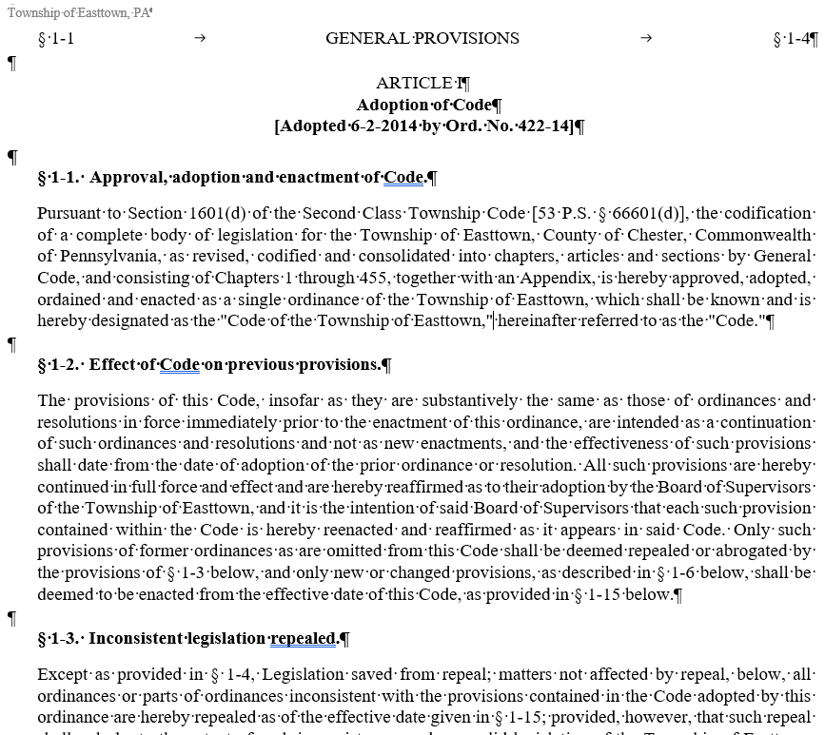
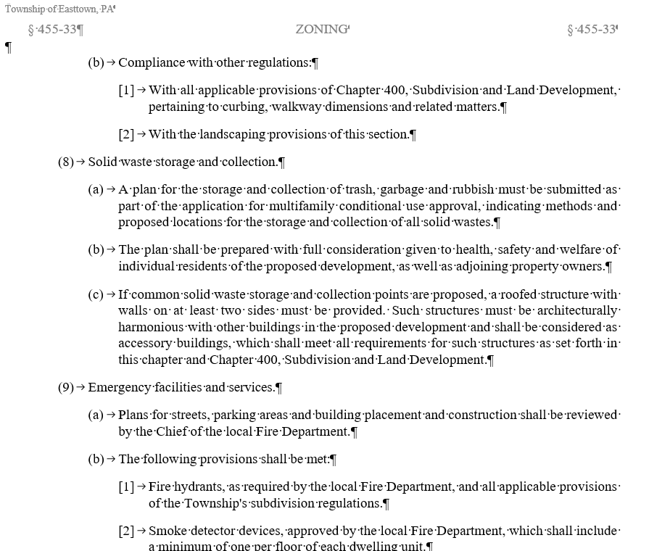
Data Source Example
ID | Name | Source | Brief Description | Format | Time Span | Num. of records | Access (Y/N)
1 | Easttown Code | eCode 360 - https://ecode360.com/EA3052 | The Laws of Easttown Township, Pennsylvania as enacted by the Board of Supervisors. | Word File | About 1940 to 10/16/2023 | 4.42 MB and 732 pages and 288,412 words | Y
Item | Description | WC
Purpose | Provides me with real world examples of large law documents that I can manipulate to create inconsistences and incompleteness. | 19
Data Treatment | For some of these documents, I will inject inconsistency and remove sections to make it incomplete. The document will be processed by a GNN to create a graph that documents the entities within the document. The graph will be processed by a Transformer to identify inconsistent or incomplete entities. | 16 19 14
Page 3 of the document. I looked for a table of contents but did not find one.
Page 531 of the document.

Slide 23
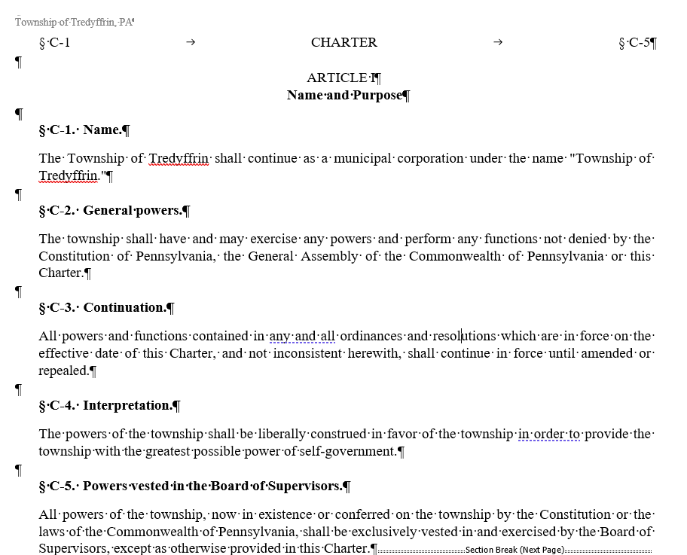
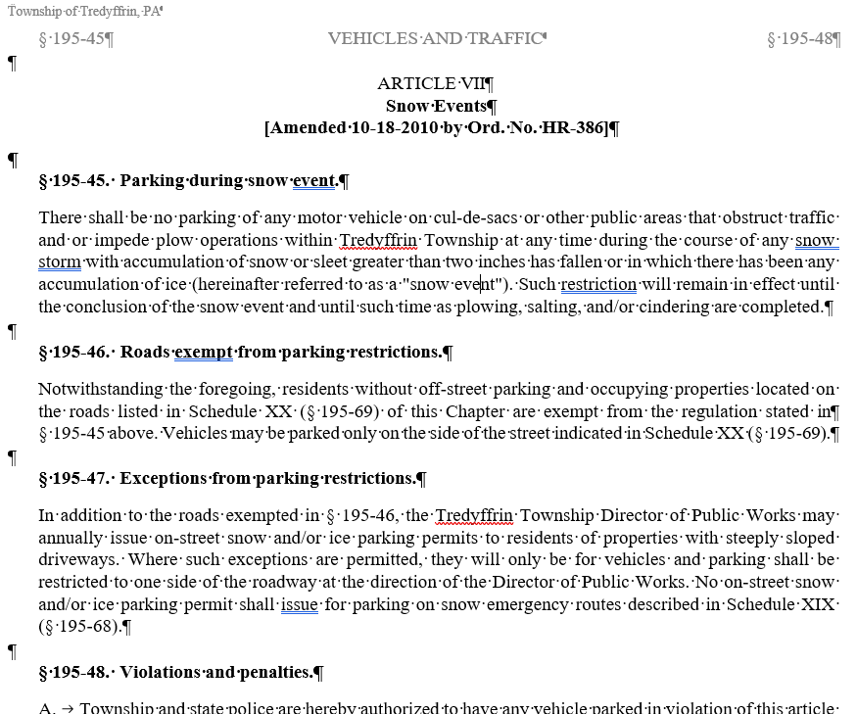
Data Source Example
ID | Name | Source | Brief Description | Format | Time Span | Num. of records | Access (Y/N)
2 | Tredyffrin Code | eCode 360 - https://ecode360.com/TR1485 | The Laws of Tredyffrin Township, Pennsylvania as enacted by the Board of Supervisors. | Word File | About 1940 to 6/17/2024 | 6.69 MB and 819 pages and 318,231 words | Y
Item | Description | WC
Purpose | Provides me with real world examples of large law documents that I can manipulate to create inconsistences and incompleteness. | 19
Data Treatment | For some of these documents, I will inject inconsistency and remove sections to make it incomplete. The document will be processed by a GNN to create a graph that documents the entities within the document. The graph will be processed by a Transformer to identify inconsistent or incomplete entities. | 16 19 14
Page 3 of the document. I looked for a table of contents but did not find one.
Page 531 of the document.

Slide 24
Appendix

Slide 25

Appendix B Chapter Guidelines

Slide 26
General Chapter Guidelines
Chapter 1 Introduction (5 pages)
Should answer:
What are you doing?
Why is it important?
What have others done?
What are you doing that’s different or better?
What do you hope to achieve?
Chapter 2 Literature Review (25-30 pages)
Should be a comparing and contrasting of the work done on the subject to date.
Should be well organized and easy to follow
This should be based on 40+ references

Slide 27
General Chapter Guidelines
Chapter 3 Methodology (25-30 pages)
No qualitative research methods (survey, grounded theory, etc.).
No method that requires the IRB
Describe any data, data manipulation, and data cleaning used
Explain the methodology with its strengths and weaknesses
Explain any variation of the methodology required to address the problem in the praxis
Chapter 4 Results (25-30 pages)
Using the results from the methodology, lead the reader through the proof of the research hypotheses
Clearly state all findings using tables and graphics

Slide 28
General Chapter Guidelines
Chapter 5 Conclusions (~5 pages)
Discuss the results of proving the research hypotheses
Clearly state any weakness or limitation in the analysis
Clearly state the scope of the study and its implications
Provide a roadmap for future research
References (5-10 pages)
Minimum 40 references

Slide 29
APA Guidelines^{(*)}
Source citation consists of:
A brief parenthetical citation in the text
A full reference at the end of the paper
APA In-text Citations
An APA in-text citation includes the author’s last name and the publication year.
If you’re quoting or paraphrasing a specific passage, you also add a page number.
1 author | (Taylor, 2018, p. 23)
2 authors | (Taylor & Kotler, 2018, p. 23)
3–5 authors | First citation: (Taylor, Kotler, Johnson, & Parker, 2018, p. 23) Subsequent citations: (Taylor et al., 2018, p. 23)
6+ authors | (Taylor et al., 2018, p. 23)
APA Reference List
Smith, T. (2019). Citing sources and referencing: A quick guide. (J. M. Taylor, Ed.) (2nd ed.). Amsterdam, The Netherlands: Scribbr.
In-text citation
According to new research (Smith, 2019, pp. 11–12) …
As mentioned before (Smith, 2019, pp. 11–12) …
(See Smith, 2019)
* https://www.scribbr.com/citing-sources/apa-vs-mla/

